Slide 1
Technology Consulting
Here is where your
presentation begins

Slide 2
Contents of This Template
Here’s what you’ll find in this Slidesgo template:
A slide structure based on a consulting sales pitch, which you can easily adapt to your needs. For more info on how to edit the template, please visit Slidesgo School or read our FAQs.
An assortment of illustrations that are suitable for use in the presentation can be found in the alternative resources slide.
A thanks slide, which you must keep so that proper credits for our design are given.
A resources slide, where you’ll find links to all the elements used in the template.
Instructions for use.
Final slides with:
The fonts and colors used in the template.
A selection of illustrations. You can also customize and animate them as you wish with the online editor. Visit Stories by Freepik to find more.
More infographic resources, whose size and color can be edited.
Sets of customizable icons of the following themes: general, business, avatar, creative process, education, help & support, medical, nature, performing arts, SEO & marketing, and teamwork.
You can delete this slide when you’re done editing the presentation.

Slide 3
Table of Contents
01
02
03
04
Problem & Solution
You could describe the
topic of the section here
Market Analysis and Target
You could describe the
topic of the section here
Our Process
You could describe the
topic of the section here
Our Consultants
You could describe the
topic of the section here

Slide 4
01
Company
Enter a subtitle here if you need it

Slide 5
Our Company
Your logo
Mercury is the closest planet to the sun and the smallest one in the solar system—it’s only a bit larger than the Moon. The planet’s name has nothing to do with the liquid metal, since Mercury was named after the Roman messenger god

Slide 6
Understanding the Problem
Neptune
Mercury
Jupiter
Neptune is the farthest planet from the Sun
Mercury is the smallest planet in the Solar System
Jupiter is the biggest planet in the Solar System

Slide 7
Our Solutions
Mercury
Venus
01
02
Mercury is the closest planet to the sun
Venus is the second planet from the sun
Jupiter
Neptune
03
04
Jupiter is the biggest planet of them all
Neptune is the farthest planet from the Sun

Slide 8
Main Competitors
 | Mercury | Jupiter | Venus | Neptune

Slide 9
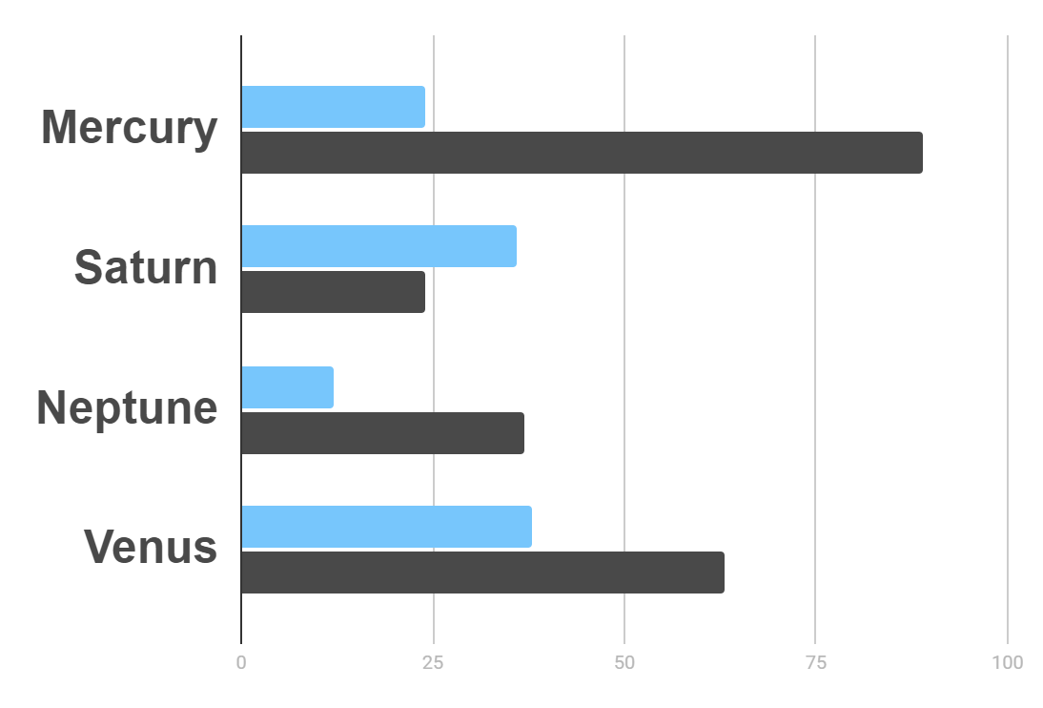
Market Research
Evolution
$20K
Gross Revenue in the Sector
10%
45K
To modify this graph, click on it, follow the link, change the data and paste the resulting graph here
Sector Growth

Slide 10

—Someone Famous
“This is a quote, words full of wisdom that someone important said and can make the reader get inspired.”

Slide 11
Awesome Words

Slide 12
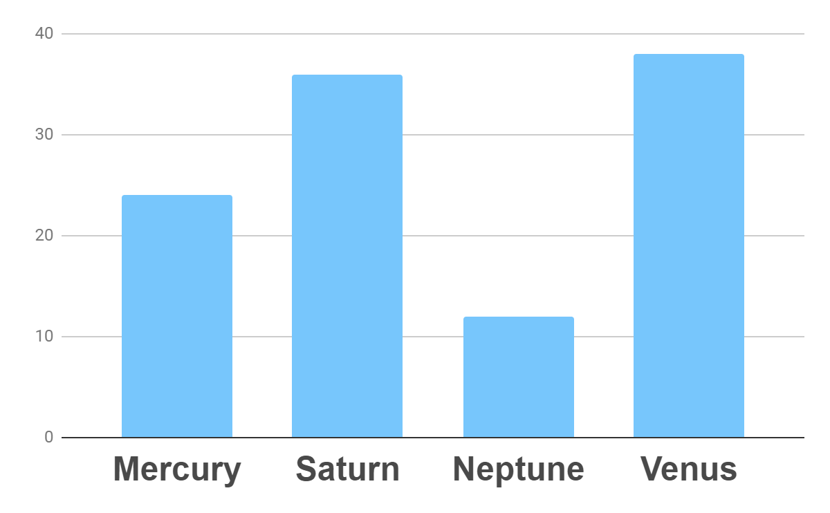
Analysis
Outreach
Top Rated Values
To modify this graph, click on it, follow the link, change the data and paste the new graph here

Slide 13
333,000.00
24h 37m 23s
386,000 km
earths is the sun’s mass
is Jupiter’s rotation period
is the distance to the Moon

Slide 14
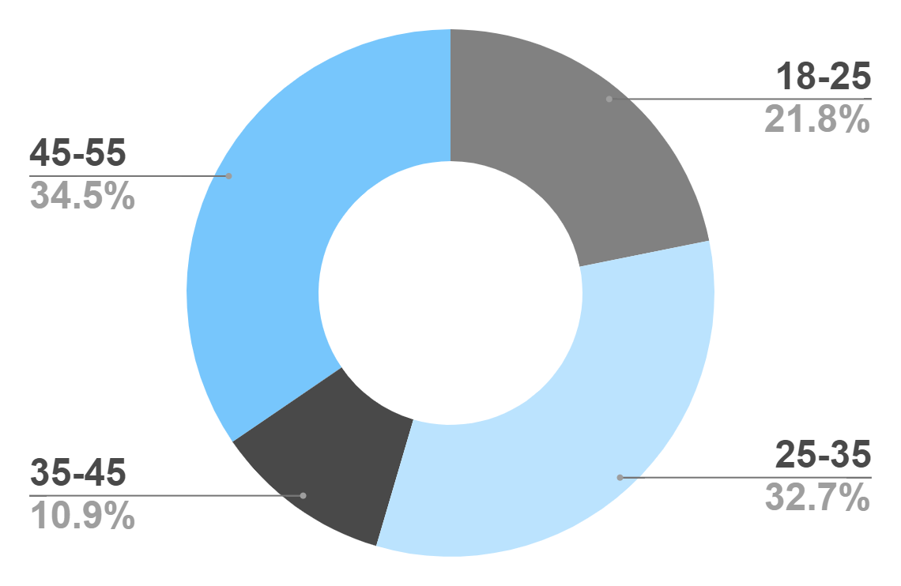
Target
Age
Gender
30%
70%
Interests
Security
Usability
To modify this graph, click on it, follow the link, change the data and paste the new graph here
Interface

Slide 15
Our Process
Mercury is the closest planet to the Sun
Venus is the second planet from the Sun
Day 1
Day 2
Day 3
Day 4
Jupiter is the biggest planet in the Solar System
Neptune is the farthest planet from the Sun

Slide 16
Whoa!
This could be the part of the presentation where you can introduce yourself, write your email…

Slide 17
Our Consultants
John James
Venus is the second planet from the Sun
Jane Patterson
Joe Doe
Mercury is the closest planet to the Sun
Neptune is the farthest planet from the Sun

Slide 18
Our Partners
Mercury
Jupiter
Neptune
Mercury is the closest planet to the Sun
Jupiter is the biggest planet of them all
Neptune is the farthest planet from the Sun
Saturn
Mars
Venus
Saturn is the ringed one and a gas giant
Despite being red, Mars is actually a cold place
Venus is the second planet from the Sun

Slide 19
Testimonials
Helena James
“Mercury is the closest planet to the Sun”
Jenna Doe
“Jupiter is the biggest planet of them all “
Mary Patterson
“Neptune is the farthest planet from the Sun”

Slide 20
Awards
Mercury
It’s the closest planet to the Sun
Venus
Venus is the second planet from the Sun
Jupiter
Jupiter is the biggest planet of them all

Slide 21
498,300,000
Big numbers catch your audience’s attention

Slide 22
Upcoming Goals
January
February
March
April
Goal 1
Phase 1
Phase 2

Slide 23
The Slide Title Goes Here!
Do you know what helps you make your point clear? Lists like this one:
They’re simple
You can organize your ideas clearly
You’ll never forget to buy milk!
And the most important thing: the audience won’t miss the point of your
presentation

Slide 24
Infographics Make Your Idea
Understandable…
Mercury
Neptune
Mercury is the closest planet to the Sun
Neptune is the farthest planet from the Sun
Jupiter
Saturn
Jupiter is the biggest planet of them all
Saturn is the ringed one and a gas giant

Slide 25
…And the Same Goes for Tables
 | Mass (earths) | Diameter (earths) | Gravity (earths)
Mercury | 0.06 | 0.38 | 0.38
Mars | 0.11 | 0.53 | 0.38
Saturn | 95.2 | 9.4 | 1.16

Slide 26
Maybe You Need to Divide the Content
01
02
Neptune
Jupiter
Neptune is the farthest planet from the Sun and the fourth-largest in the Solar System
Jupiter is the biggest planet in the Solar System and the fourth-brightest one

Slide 27
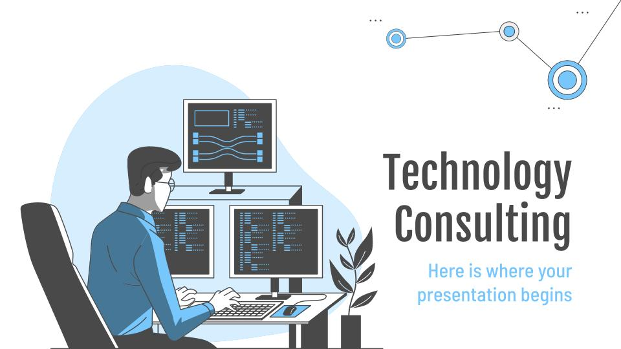
Desktop Software
You can replace the image on
the screen with your own
work. Just delete this one,
add yours and center it properly

Slide 28
Thanks!
Do you have any questions?
youremail@freepik.com
+91 620 421 838
yourcompany.com
Please keep this slide for attribution

